Slide 1
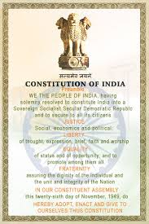
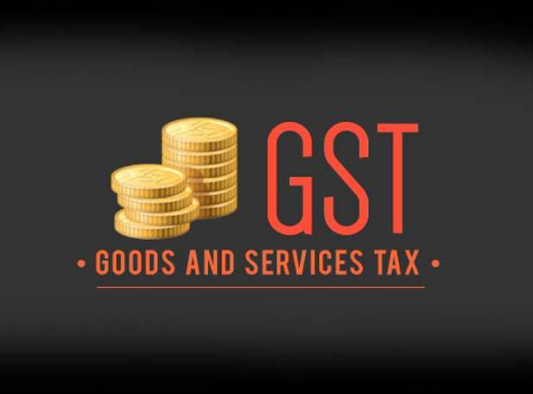

Overview I Impact I Implications I Management
Goods and Services Tax
“1 Nation Tax Market”

Slide 2

Agenda
Agenda
Journey so far
Design of GST
Main features of GST Law
Administration and IT Network
Benefits of GST and Way Forward

Slide 3

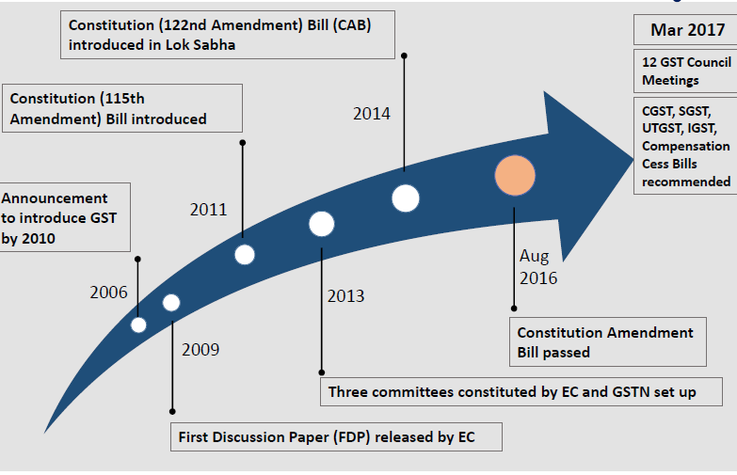
The Journey so far

Slide 4
Next Key steps before the law gets enforceable by April 1, 2017 deadline-
1. It will decide the revenue neutral rate (RNR), the rate at which there will be no loss in aggregate central and state tax revenue.
2. The RNR will then get converted into a three-slab GST rate structure, depending on exemptions. Essential commodities will be charged at low rates offset by higher 'sin' taxes on goods considered to be luxuries. A so-called standard or GST rate will be the middle slab and will apply to most goods and services.
3. The IGST rate will be split between and central GST and state GST. The split shares will be decided by the GST Council.
4. Three more laws will need to be passed: laws on the Central GST (CGST), integrated GST (IGST) and 29 separate state GST legislations (SGST)
While the first two laws will be cleared by Parliament, the third law will be cleared by the respective state assemblies.
With GST Bill having been passed in Rajya Sabha, parallel news reports relating to readiness of IT backend of GST viz. GST Network (‘GSTN’) have started pouring in. GSTN will be ready for testing in October 2016 and the beta version will be launched in February 2017.

Slide 5
Benefits of GST
Overall reduction in Prices for Consumers
Reduction in Multiplicity of Taxes, Cascading and Double Taxation
Uniform Rate of Tax and Common National Market
Broader Tax Base and decrease in “Black” transactions
Free Flow of Goods and Services – No Checkpoints
Non-Intrusive Electronic Tax Compliance System

Slide 6
PART A- OVERVIEW

Slide 7
GST Council - Constitution
Consists of Finance Minister, the MOS (Finance) and the Minister of Finance / Taxation of each State
Chairperson – Union FM
Vice Chairperson - to be chosen amongst the Ministers of State Government
Quorum is 50% of total members
Decision by 75% majority
Council to make recommendations on everything related to GST including laws, rules and rates etc.

Slide 8

A tax charged on supply of Goods and Services or both for consideration.
GST is a destination based consumption tax.
GST is a value added tax to be levied on both goods and services, (except the exempted goods and services).
The tax will be levied on the value of the product or service supplied and not sold.
WHAT IS GST
Multi Stage Tax
Seamless Credit across entire supply chain
Destination based consumption tax
Value Added Tax

Slide 9
CONSTITUENTS OF GST
Revenue will be ultimately received by the state in which goods are finally consumed
GST
Intra- State
Inter- State
CGST
SGST
IGST

Slide 10
TAXES TO BE SUBSUMED
TAXES NOT TO BE SUBSUMED
Central Excise Duty
Additional Excise duties
Excise duty levied under the Medicinal and Toiletries Preparation Act
Service Tax
Additional Customs Duty
Special Additional Duty
Surcharges and cesses relating to supply of goods and services
VAT/ Sales Tax
Central Sales Tax
Entertainment Tax(other than levied by local bodies)
Purchase Tax
Luxury Tax
Taxes on lottery, betting and gambling
State surcharges and cesses relating to supply of goods and services
Central levies State levies
Basic Customs Duty
Excise Duty/VAT on Petroleum Products for initial years(In addition to GST at Nil rate)
Excise Duty on Tobacco Products(in addition to GST)
Electricity Duty by state (in addition to GST)
Entertainment Tax levied by local bodies
State excise on Alcoholic Beverages(No GST)
Tolls, passengers and Goods tax on carriage by road/ railway
Property Tax, stamp duty and taxes on immovable properties
Royalty on minerals , Environmental/regulatory taxes- e.g. vehicles tax
GST

Slide 11
EXISTING TAX STURUCTURE
11
Taxable Event is Import & Export
Entry No. 83, List I, Schedule VII
Customs Duty
Taxable Event is Sale
Entry No. 54 of List II (VAT) and 92A of List I (CST)
Sales Tax / VAT/ CST
Taxable Event is Provision of Service
Residuary Entry No. 97, List I, Schedule VII
Service Tax
Taxable Event is Manufacture
Entry No. 84, List I, Schedule VII
Excise Duty
Present Tax Structure
[5 Important Constituents]
Entry Tax/ Entertainment Tax
Entry No. 52 &62 List II, Schedule VII
Taxable Event is Entertainment & Entry of Goods

Slide 12
GST TAX STURUCTURE
12
Intra State Taxable Supply
Excise and Service Tax will be known as CGST
Local VAT & Other taxes will be known as SGST
Inter State Taxable Supply
CST will be replaced by Integrated GST (IGST)
Import From Outside India
Custom Duty
Approx. Sum Total of CGST and SGST
In Place of CVD and SAD, IGST will be charged

Slide 13
Overview of the new landscape
Taxable event
Place of supply
Exemptions
Taxable event to be ‘supply’
States to levy tax on services
Destination based tax
Rules for services?
Likely to either be withdrawn or be converted into refund mechanism
Valuation
Likely to be consistent for all goods and services – MRP valuation may go
Multiplicity of taxes
GST to subsume most current indirect taxes
To be replaced by CGST and SGST, IGST
Credit
Rates
Possible expansion of credit base
Credit pool to be maintained for each state
Tax rates to change for inputs and outputs
Classification

Slide 14
Taxable Event
Existing Practice
Excise Duty-Manufacturing,
Sales Tax/VAT- Sale of Goods
GST
Taxable event is “Supply “ of Goods & service
Service Tax- Realization of Service
The location of the supplier and the recipient within the country is immaterial for the purpose of CGST.
SGST would be chargeable only when the supplier and the recipient are both located within the State.
Inter state Supply of goods and services will attract IGST.

Slide 15
Applicable on Supply- Section 3- Meaning and Scope of Supply
•Supply includes supply of goods and services
Sale Transfer Barter | Exchange License Rental | Lease Disposal Importation of services
Schedule I - Matters to be treated as supply without consideration
1. Permanent transfer/ disposal of business assets.
2. Temporary application of business assets to a private or non-business use.
3. Services put to a private or non-business use.
4. Assets retained after deregistration.
5. Supply of goods and / or services by a taxable person to another taxable or nontaxable person in the course or furtherance of business.

Slide 16
Taxation of self supplies including inter-branch supplies under Schedule I?
Taxation of supplies without a consideration: free promotional supplies of goods and services
Importation of service from group entities/ overseas offices without cross charge – issues around monitoring / reporting-w.r.t. Holding and Subsidiary Companies where they are related entities
Deposits (refundable or otherwise) not to be taxed until adjustment
No specific categorization for composite supplies as supply of goods/ services – no specific provisions under Model Law
Taxation of individuals – threshold to be monitored
Taxability of business transfer arrangements – clarity awaited
Key Points for Discussion

Slide 17
In any other case
GST payable as per time of supply
Sec 11- Time of Supply of Goods
On the basis of the Movement of Goods
Goods required to be moved
Date on which the goods are removed by the supplier for supply to the buyer
Goods not required to be moved
Date on which goods are made available to the buyer.
On the basis of transactions- either of the following
Date of issue of invoice by supplier
Date of receipt of payment by supplier
Date of receipt of goods entered into books of accounts of buyer.
On the basis of continuous supply of goods
Successive statement of accounts and payments involved
Date of expiry of period to which it relates
Successive statement of accounts and payments not involved
Date of issue of invoice or
Date of receipt of payment whichever is earlier
When goods are sent or taken on approval or sale or return or similar terms
In this goods are removed before it is known whether the supply will take place
Time when it is known that supply has taken place or
12 months from the date of removal ,Whichever is earlier
Periodical return has to be filed
Date on which such return has to be filed
Periodical return no to be filed
Date of payment of CGST/ SGST
In any other case

Slide 18
GST payable as per time of supply
Sec 12- Time of Supply of Services
On the basis of issue of Invoice
Invoice issued within the prescribed period
Date of issue of invoice or date of receipt of payment whichever is earlier
Invoice not issued within the prescribed period
Date of completion of provision of service or the date of payment whichever is earlier
In other case
Date on which the recipient shows the receipt of service in his books of accounts
On the basis of continuous supply of services
If the due date is ascertainable
Date of liability of payment to service provider
If the due date is not ascertainable
Date of receipt of payment or issue of an invoice whichever is earlier
In other situations
-the payment is linked to the completion of an event | When the event gets completed
-if tax is paid on reverse charge basis | Earliest of- Date of receipt of services Date of payment Date of receipt of invoice Date of debit in books of accounts
Supply ceases before completion of service | At the time of cessation
In any other case
Periodical return has to be filed
Date on which such return has to be filed
Periodical return no to be filed
Date of payment of CGST/ SGST

Slide 19
Place of Supply
Typically for ‘goods’ the place of supply would be location where the good are delivered. Whereas for ‘services’ the place of supply would be location of recipient.
Distance supply+ Movement of goods | Place of delivery of goods
No movement of goods | Place of delivery of goods(handed over to receiver)
Assembly/ installation of goods at site | Place of such installation/ assembly
Supplied on board/ conveyance/ vessel | Such place
Other cases | As recommended by Govt
Services related to
Immovable property
Restaurant and catering service
Artistic/ sporting/scientific/ educational/ Entertainment
Transportation of goods
Passenger transportation service
Board a conveyance/ vessel etc
Telecommunication service
Banking/ other financial service
Insurance services
Advertisement services
Provided to registered person
Location of Service recipient
Not provided to registered person
Location of Service provider

Slide 20
Unrelated Parties
• Transaction value (TV) to be price actually paid / payable including following:
– Actual royalties & license fees, payable as condition of supply
– Incidental expenses and reimbursements charged by supplier except pure agent
– Charges payable by supplier but actually paid by recipient & not charged by supplier
– Apportioned value of supplies provided by recipient to supplier free or at reduced cost
– Subsidies, post sale discounts or incentives, any taxes other than GST
Related Parties
• TV to be accepted provided the relationship has not influenced price
Other Cases
• Reasons to doubt the truth / accuracy of TV or appears relationship has influenced TV, TV to be determined sequentially as follows:
– Value of goods and/or services of like kind and quality; subject to commercial adjustments
– Computed value comprising of cost of production/provision of goods and / or services, design / brand charges, general expenses and reasonable profit
– Best judgment or residual method basis in accordance with valuation principles
VALUATION-Concept similar to current customs and central excise valuation

Slide 21
Imports/ exports and domestic supplies to be subject to these provision?
Challenges in valuation of non monetized supplies/ barters/ exchanges
Notional additions to value in case of related party transactions as well as where the proper officer doubts the accuracy of the transaction value declared
Issues in share valuation in acquisitions and buy backs?
Key Points for Discussion

Slide 22
General Provisions
• Registered person entitled to credit of tax charged on goods / services used / intended to be used for business (nexus), irrespective of place of supply
Restrictions on input tax credits (similar to current regime) – no credit on inputs/ input services used for private or personal consumption
– Reversal in respect of non-business use or exempt / non-taxable supplies
– Credit of motor vehicle, construction works contract, employee related expenses ineligible
– No credit of tax charged by person availing composition scheme
• Credit available in respect of inputs / capital goods directly sent to job-worker subject to conditions, however credit not available in respect of input services used by job-worker
• No provision for adjustment of tax in case of bad debts
• Credit to be availed within one year from date of invoice; subject to earlier of filing of annual return (31st December) or return for month of September (20th October) following end of financial year
• Provision regarding transfer of input tax in case of sale, merger ,transfer etc. of business
• Distribution of credit by Input service distributor, largely in alignment with existing principles
INPUT TAX CREDIT

Slide 23
Proposed Flow of ITC Credit-ITC credit of SGST is not available for CGST or vice-a-versa
Claim of Input Tax Credit ('ITC')
• Input tax credit to be allowed basis electronic ledger;
– Every taxable person to upload details of all inward & outward supplies electronically
– Provisional entitlement of tax credit basis self-assessment
– Matching of ITC claim based on inward supplies with corresponding outward supplies
– Recipient liable to pay tax if mis-match arises; in month of communication of such mis-match
– Upon rectification by supplier, output tax liability of recipient reduced to extent of above payment
– Matching of output tax liability reduction claim of supplier with corresponding reduction of input tax credit by recipient
INPUT TAX CREDIT
23
IGST Input
IGST
Output
SGST Input
SGST
Out put
CGST Input
CGST
Out put

Slide 24
GST Set off Chain
Manufacturer
Input Credit of Goods+ services
After taking set off of Input credit, pay the Output Liability on value addition
Wholesaler
Input Credit of Goods+ services from manufacturer
After taking set off of Input credit, pay the Output Liability on value addition
Retailer
Input Credit of Goods+ services from wholesaler
After taking set off of Input credit, pay the Output Liability on value addition
Consumer
Ultimate Output Liability recovered from consumer

Slide 25
CONCEPT OF IGST
Centre would levy IGST which would be CGST plus SGST on all Inter State transactions,
The inter-State seller will charge & pay IGST in his state on value additions after adjusting available credit of IGST, CGST, and SGST on his purchases,
The Exporting State will transfer to the Centre the credit of SGST used in payment of IGST,
The Importing dealer will claim credit of IGST while discharging his output tax liability in his own State,
The Centre will transfer to the importing State the credit of IGST used in payment of SGST,
The relevant information will also be submitted to the Central Agency which will act as a clearing house mechanism.

Slide 26
GST rate has not been defined in the draft law released.
Report submitted by Chief Economic Adviser of India(Mr. Arvind Subramanium) has recommended following rates
The Revenue Neutral Rate to be between 15-15.5% (Centre and states combined)
Lower rates be kept around 12% (Centre plus States)
Standard rate of GST between 17-18%
LIKELY RATE OF GST
Summary of Recommended Rate Options (in percent)
RNR | Rate on precious metals | "Low" rate (goods) |  | "Standard" rate (goods and services) | "High/Demerit" rateor Non-GST excise (goods)
Preferred | 15 | 6 | 12 | 16.9 | 40
 |  | 4 |  | 17.3
 |  | 2 |  | 17.7
Alternative | 15.5 | 6 | 12 | 18.0 | 40
 |  | 4 |  | 18.4
 |  | 2 |  | 18.9

Slide 27
INDUSTRY EXPECTATIONS FROM GST
Low compliance cost- unlikely
Simple business processes-near to reality
Less requirement of automation initially-unlikely
Minimal ITC refund cases –near to reality
Exemptions instead of exclusions from GST-possible
Seamless flow of input credit-possible
Seamless flow of information between, supplier, buyer and tax administration-possible
Need for IT portal or agency like TINXSYS, NSDL- required
Automation of process by way of e-registrations, e-returns, e-payment-required
No requirement of verifications during inter state movement of Goods-unlikely
Zero rating of supplies to exporters
Administrative efficiency in case of assessment and adjudication
Ease of compliance-unlikely
Self-policing-required

Slide 28
Will it reduce the price of Products?
Will it reduce the cost of services?
Will it increase Government revenue?

Slide 29
GST-Registration
Exemption limit of INR 9 lacs of aggregate turnover (single PAN) of outward supplies (INR 4 lacs for
north east states including Sikkim)
– Aggregate Turnover defined as aggregate value of all taxable, non-taxable, exempt supplies and
exports
– Compulsory registration without exemption for person undertaking inter-state supplies
– PAN mandatory to obtain registration except for non-resident person
– Person dealing exclusively in exempt goods / services not liable to obtain registration
– Special provisions for registration of casual / non-resident person; registration for 90 days
(further extendable by 90 days); advance deposit of estimated tax
• Transitional provisions for registered dealers under current regime
• Option to obtain business vertical-wise registration in same state
• State based registrations; concept of centralized registration done away with
Accounts & Records
• In case of multiple place of businesses, records to be maintained at each place relevant to business
transacted at such place
• Prescribed accounts to be maintained for 60 months from last date of filing annual return for relevant
financial year

Slide 30
GST-Refund
Refund of unutilised input tax credits allowed in cases where:
– goods / services exported outside India or;
– Inverted duty structure;
• Refund application can be filed within two years of the relevant date; time limit not applicable in
respect of deposits made under protest
• In case of multi state operations, application to be filed in respective states; instead of single
application as done presently
• Unjust enrichment to be established; for refunds less than 5 lacs self declaration to suffice
• Provision of 80% provisional refund subject to conditions to be notified
• Provision to withhold or deduct refund claim in case of non-filing of return or pending tax demand
but not stayed by any court or appellate authority
• Refund provisions for Specialised agencies like United nations or any multilateral Financial Institution or other notified person

Slide 31
GST-Return
Return Form | What to file? | By Whom? | By When?
GSTR-1 | Details of outward supplies of taxable goods and/or services effected | Registered Taxable Supplier | 10th of the next month
GSTR-2 | Details of inward supplies of taxable goods and/or services effected claiming input tax credit. | Registered Taxable Recipient | 15th of the next month
GSTR-3 | Monthly return on the basis of finalization of details of outward supplies and inward supplies along with the payment of amount of tax. | Registered Taxable Person | 20th of the next month
GSTR-4 | Quarterly return for compounding taxable person. | Composition Supplier | 18th of the month succeeding quarter
GSTR-5 | Return for Non-Resident foreign taxable person | Non-Resident Taxable Person | 20th of the next month
GSTR-6 | Return for Input Service Distributor | Input Service Distributor | 13th of the next month
GSTR-7 | Return for authorities deducting tax at source. | Tax Deductor | 10th of the next month
GSTR-8 | Details of supplies effected through e-commerce operator and the amount of tax collected | E-commerce Operator/Tax Collector | 10th of the next month
GSTR-9 | Annual Return | Registered Taxable Person | 31st December of next financial year
GSTR-10 | Final Return | Taxable person whose registration has been surrendered or cancelled. | Within three months of the date of cancellation or date of cancellation order, whichever is later.
GSTR-11 | Details of inward supplies to be furnished by a person having UIN | Person having UIN and claiming refund | 28th of the month following the month for which statement is filed

Slide 32
PART B- CONSTITUTIONAL AMENDMENT

Slide 33
  Key Features-122nd Amendment Bill introduced in LS on 19.12.2014
        Concurrent jurisdiction for levy of GST by the Centre and the States –proposed Article 246A
        Authority for Centre to levy & collection of IGST on supplies in the course of inter-State trade or commerce including imports – proposed Article 269A
        Authority for Centre to levy non-vatable Additional Tax – to be retained by originating State
        GST defined as any tax on supply of goods or services or both other than on alcohol for human consumption – proposed Article 366(12A)
        Goods includes all materials, commodities & articles – Article 366 (12)
        Services means anything other than goods – proposed Article 366 (26A)
        Goods and Services Tax Council (GSTC) - proposed Article 279A
        Changes in entries in List – I & II
        Compensation for loss of revenue to States for five years

Slide 34
  New amendments to 122nd Constitutional Amendment Bill 2014
  (as circulated in Rajya Sabha on August 1, 2016)
1. Scrapping of 1 percent additional tax on inter-state supply of goods.
2.Parliament must provide compensation to States for loss of revenue on account of implementation of GST upto 5 years, but may allow decide a shorter time period.
3.Redesigning of framework for distribution of CGST and IGST that will be collected by the Centre, amongst the Centre and States.
4.IGST collected by the Centre and apportioned to State, not to form part of Consolidated Fund of India.
5.The GST Council shall establish a standing mechanism to adjudicate any dispute arising out of its recommendations.

Slide 35
GST COUNCIL-The Union Cabinet has approved setting up of GST Council and setting up its Secretariat as per the following details:
a) as per Article 279A of the amended Constitution;
b) office at New Delhi;
c) Appointment of the Secretary (Revenue) as the Ex-officio Secretary to the GST Council;
d) Inclusion of the Chairperson, Central Board of Excise and Customs (CBEC), as a permanent invitee (non-voting) to all proceedings of the GST Council;
e) one post of Additional Secretary to the GST Council in the GST Council Secretariat (at the level of Additional Secretary to the Government of India), and four posts of Commissioner in the GST Council Secretariat (at the level of Joint Secretary to the Government of India).
The council will be chaired by Union Finance Minister Sh. Arun Jaitley and members comprising of State Finance Ministers.
FUNCTIONS-ADVISORY IN NATURE
As per Article 279A (4), the Council will make recommendations to the Union and the States on important issues related to GST, like
• the goods and services that may be subjected or exempted from GST,
• model GST Laws,
• principles that govern place of supply,
• threshold limits,
• GST rates including the floor rates with bands,
• special rates for raising additional resources during natural calamities/disasters,
• special provisions for certain states, etc.

Slide 36
PART C- CHALLENGES AHEAD

Slide 37
Operational Areas to be impacted by GST- CMA’s to play significant role
Procurement and Sourcing
Sales and marketing
Logistics
Product Pricing
Profitability
Distribution
Working Capital
Accounting
Human Resource
Current & Future investments

Slide 38

Likely challenges for tax payers
A new tax law – a whole lot of tax controversies
Transaction restructuring
Transition
Costing / Pricing of goods
Transaction structuring to be reviewed
Procurement pattern and trading models to be analysed – No significant difference between local and interstate under GST?
Billing patterns, local vis-à-vis inter state to be reviewed
Transition of credits
New registrations
Change in contract clauses
Review of procurement costs
Taxability of transactions spread across regimes
Treatment of tax paid inventory
Overall pricing of goods – factoring of GST credits
Change in rate of taxes
Compliance
Tax computations
New formats for invoices / records/ returns/ declarations
Validity of statutory form (Form F/Form C)
Manner of payment of taxes
New compliance dates
Documentation for movement of goods
Re-designing of the entire ERP
Records/ Accounting
Current ERP is aligned as per the current taxes
Change in accounting
Re-defining the logics
Updating masters
State-wise sales records
Credit availment and utilization records

Slide 39
Difference in SGST rates – likely challenges
SGST rate
Jurisdiction disputes
Customer state wise SGST rates for billing purposes
Tax driven supply chain planning to continue
May impact port of import decisions
Multitude of audits, investigations
Distortion of trade

Slide 40
Transitional Challenges
Tax Credit for person registered under earlier law
Provision in respect of goods returned by Job-worker
Goods sent on sale or approval basis
Provision in respect of adjustment to price of goods / services
Person becoming liable to tax under GST but not liable to tax / registration under earlier law
Person switching from normal levy to composition levy under GST
Provision in respect of duty paid / exempted goods returned

Slide 41
Likely challenges to enforcement agencies
Managing risk of GST fraud
Training needs
Robust GSTN and online compliances
Taxation of services by States
Role of customs authorities
Key challenges
Coordination between state & central departments

Slide 42
PART D- PREPARING FOR GST

Slide 43
Issues to be addressed with new regime
Supply based taxation
Taxability of inter-unit transfers
Job-work / tolling arrangements
Determining consumption state
Determining origin state
Taxing jurisdiction in case of chain transactions
Taxation of imports

Slide 44
Issues to be addressed with new regime
Valuation of stock transfers – market value or 110% of manufacturing cost and valuation of inter unit
Supplies
IGST on imports - to be computed on sum of transaction value & BCD (similar to computation of CVD) or
transaction value alone?
Scope & valuation provisions for transactions without consideration
Concessional Procurement rates for electricity generation
Remission of tax on supplies found deficient in quantity - reasons other than natural causes
Eligibility of credit on construction works contract for setting up business/factory/office
Scope of expression 'input tax charged to him' under definition of input tax
Clarity on timing of availment of Input tax credit
CGST Registration – whether single or State specific
©

Slide 45
Opportunities and challenges for CMA in GST
Opportunities
► Expansion of scope – increase in number of assesse
► Equal opportunity – evolving tax law
► Supporting business for cost effective business model
► Participation in development of Systems, process and controls
► Tax Credit reconciliations
Challenges
► Enhancement of Skills – Subject Knowledge / Presentation
► Gain visibility in organization - demonstrate passion / ownership of issue
► Build Reputation in Government - to get statutory recognition

Slide 46
HOW TO PROCEED?
1. Current taxes vs. GST structure
2. Sources of procurement to be evaluated
3. Tax Structure to be captured in the present system
4. Understanding impact of GST
5. Devising new Business Models
6. Re-designing Supply Chain
7. Implementation of GST model after final legislation
8. Training for smooth implementation of GST
9. Follow up and continuous supervision

Slide 47
Following clauses of the report issued on refund and return are referred where reference has been given for CA certification only-

Slide 48
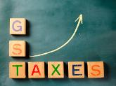
A quick guide to India GST rates in 2017
The government has kept a large number of items under 18% tax slab. The government categorised 1211 items under various tax slabs. Here is a low-down on the tax slab these items would attract:
No tax Goods
No tax will be imposed on items like fresh meat, fish chicken, eggs, milk, butter milk, curd, natural honey, fresh fruits and vegetables, flour, besan, bread, prasad, salt, bindi. Sindoor, stamps, judicial papers, printed books, newspapers, bangles, handloom, etc
5% Goods
Items such as fish fillet, cream, skimmed milk powder, branded paneer, frozen vegetables, coffee, tea, spices, pizza bread, rusk, sabudana, kerosene, coal, medicines, stent, lifeboats will attract tax of 5 %,
12% Goods
Frozen meat products , butter, cheese, ghee, dry fruits in packaged form, animal fat, sausage, fruit juices, Bhutia, namkeen, Ayurvedic medicines, tooth powder, agarbatti, colouring books, picture books, umbrella, sewing machine, cellphones will be under 12 % tax slab.

Slide 49
Services
N on-AC hotels, business class air ticket, fertilisers, Work Contracts will fall under 12 per cent GST tax slab
5-star hotels, race club betting, cinema will attract tax 28 per cent tax slab under GST
28% Goods
Chewing gum, molasses, chocolate not containing cocoa, waffles and wafers coated with choclate, pan masala, aerated water, paint, deodorants, shaving creams, after shave, hair shampoo, dye, sunscreen, wallpaper, ceramic tiles, water heater, dishwasher, weighing machine, washing machine, ATM, vending machines, vacuum cleaner, shavers, hair clippers, automobiles, motorcycles, aircraft for personal use, will attract 28 % tax - the highest under GST system.

Slide 50
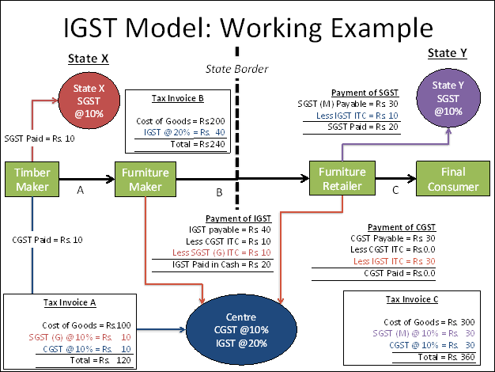

Slide 51
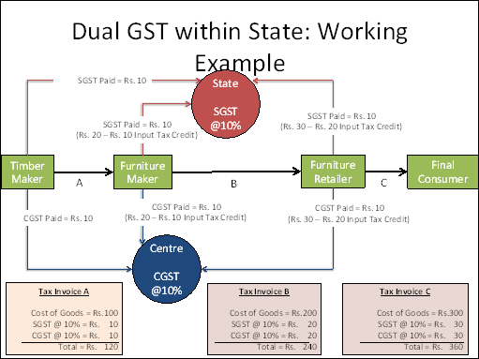

Slide 52
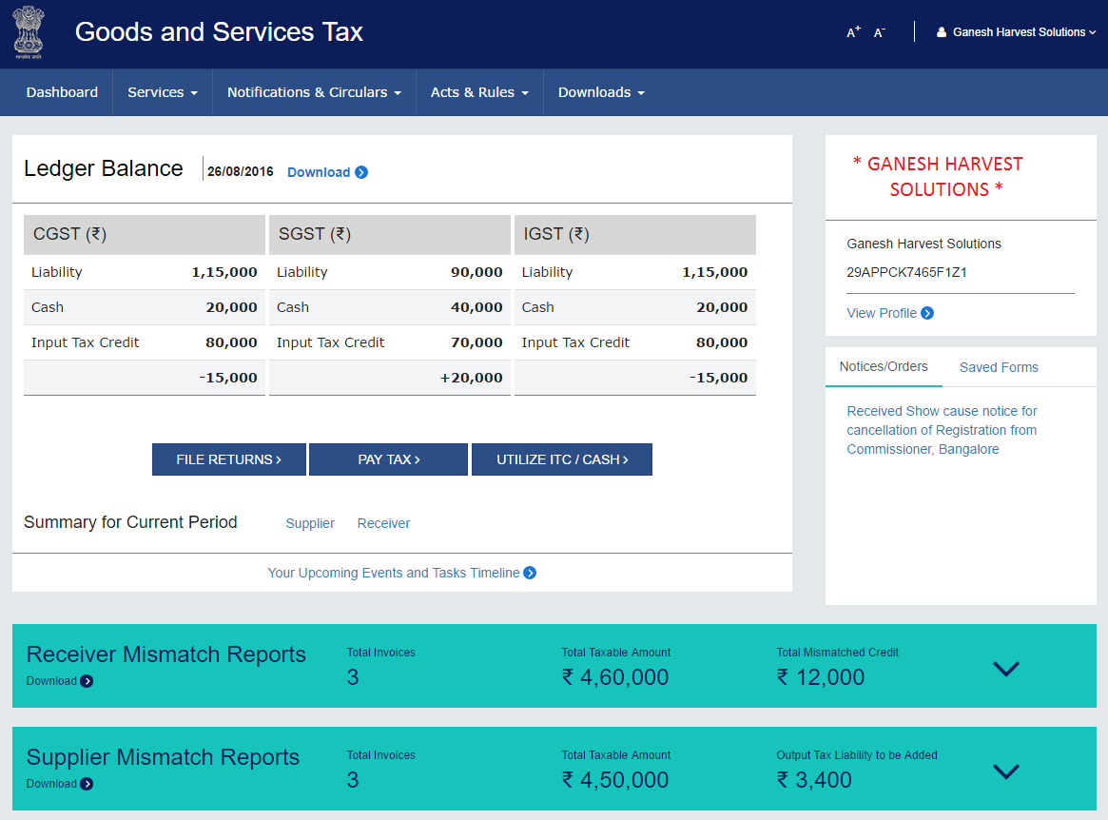

Slide 53
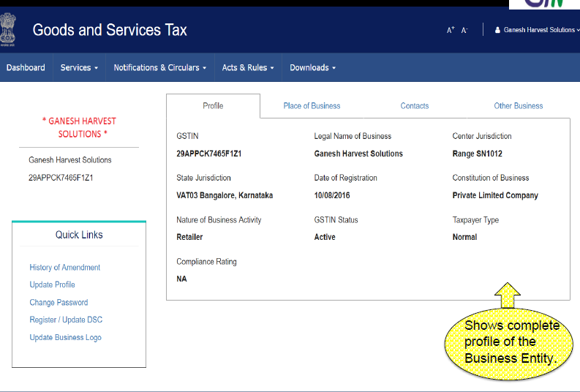

Slide 54
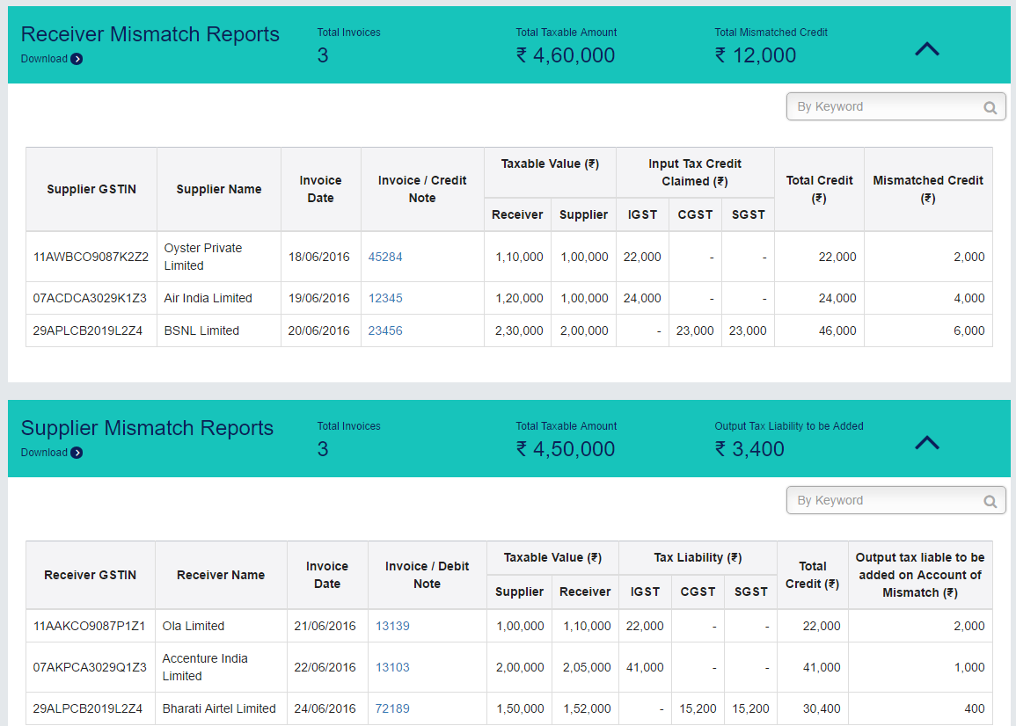

Slide 55
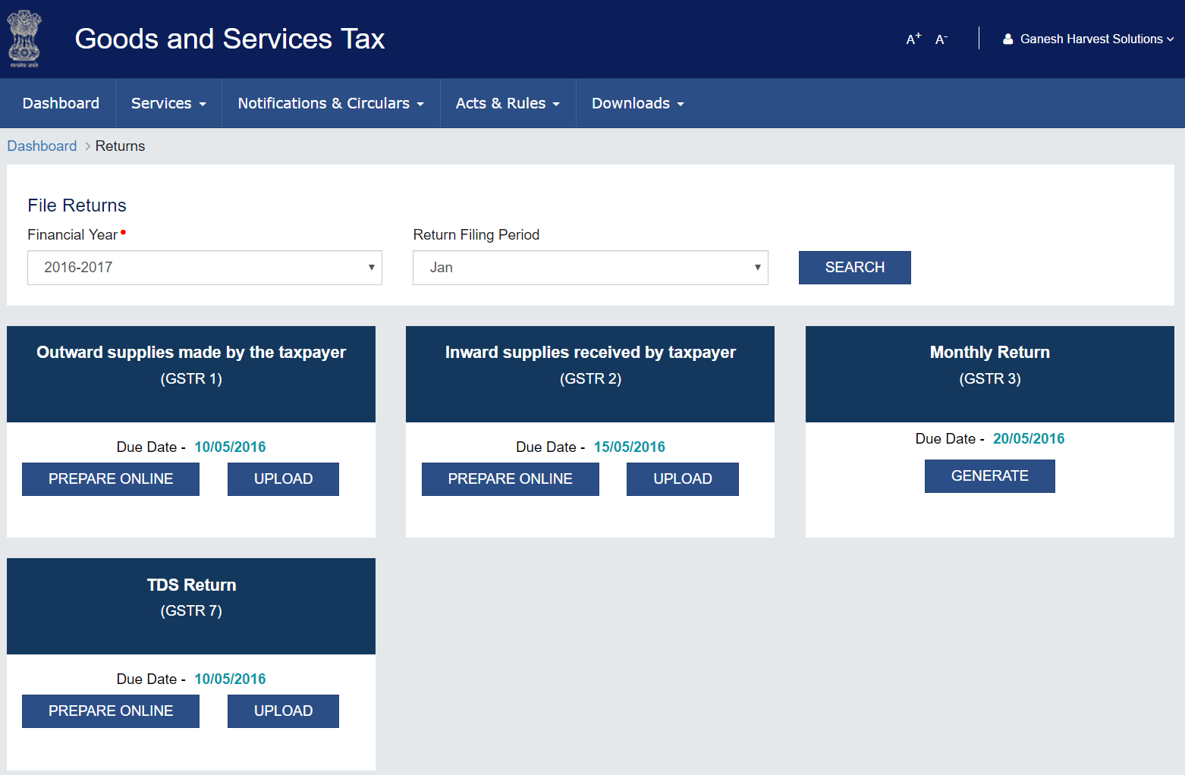

Slide 56
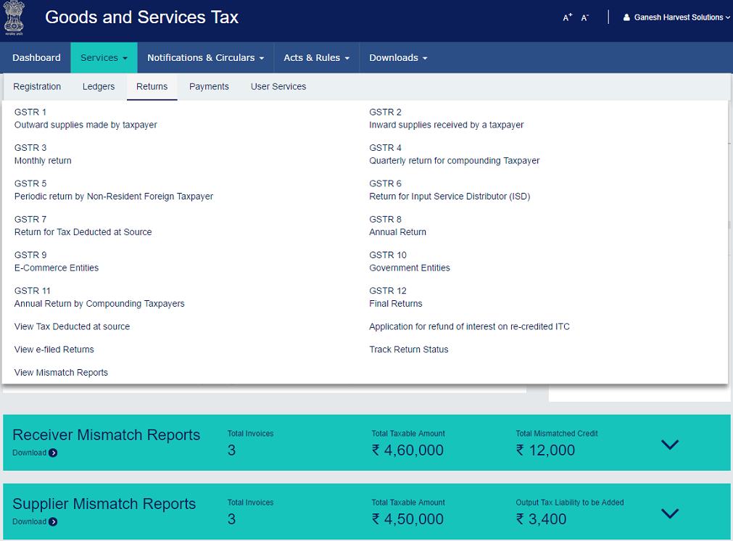

Slide 57
Return Filing

Slide 58
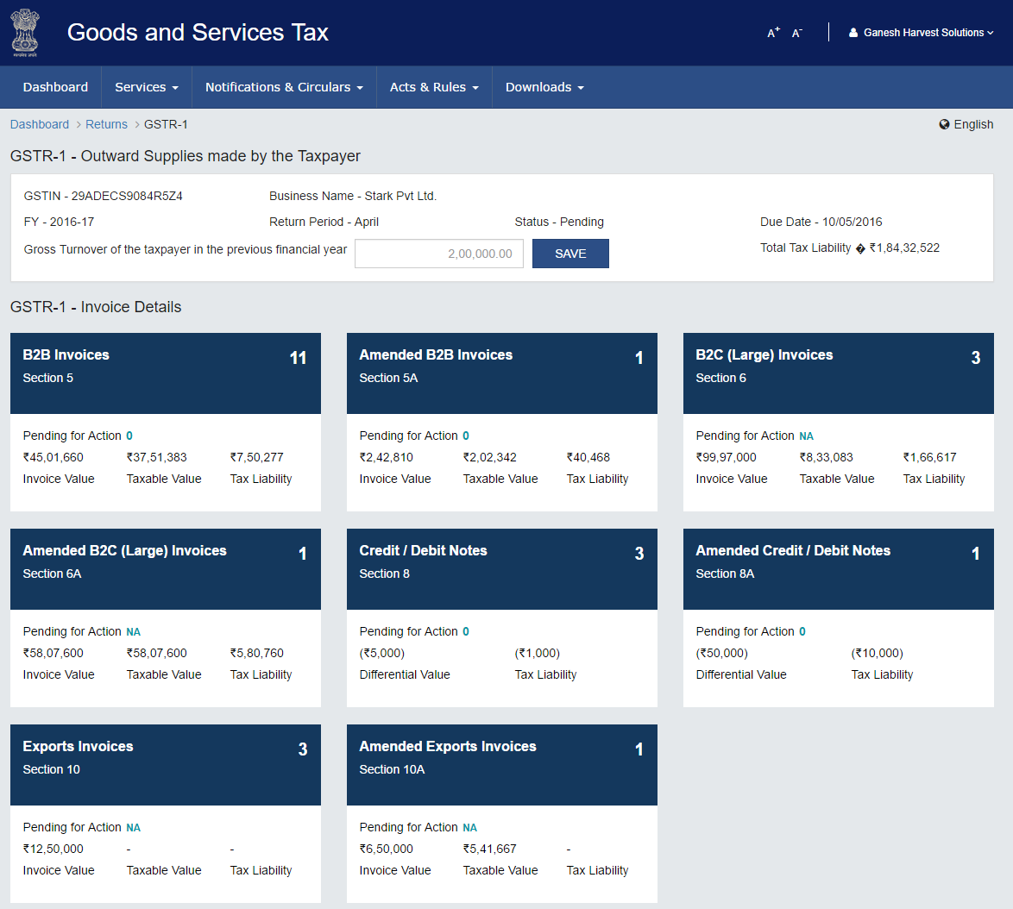

Slide 59
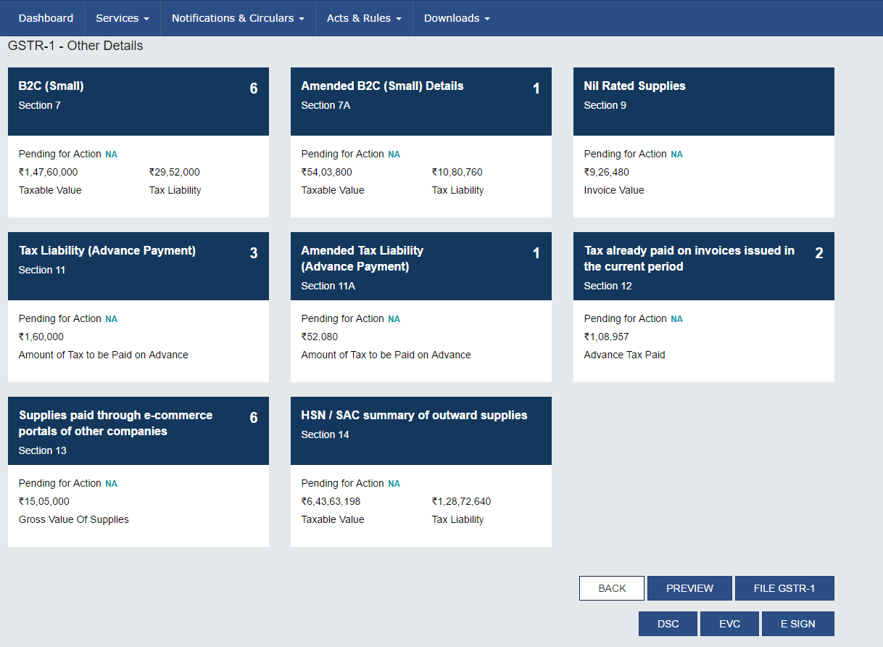

Slide 60
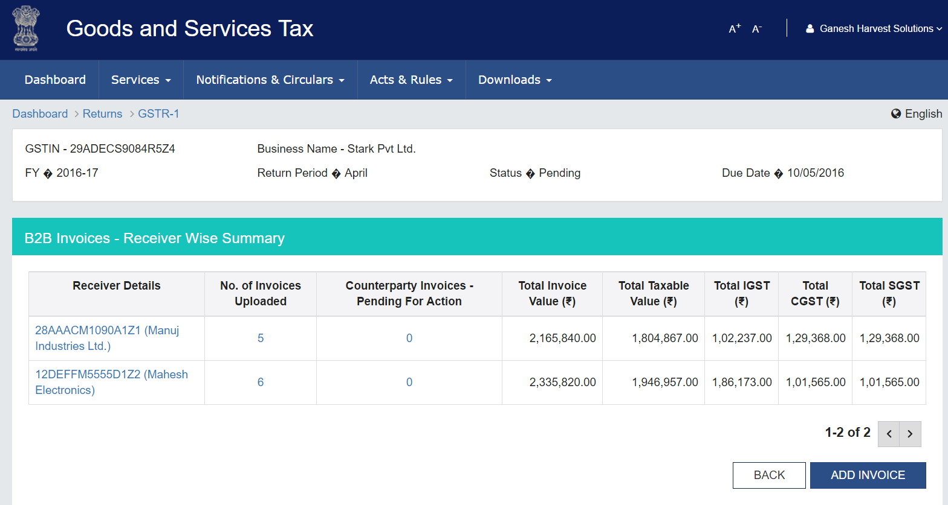

Slide 61
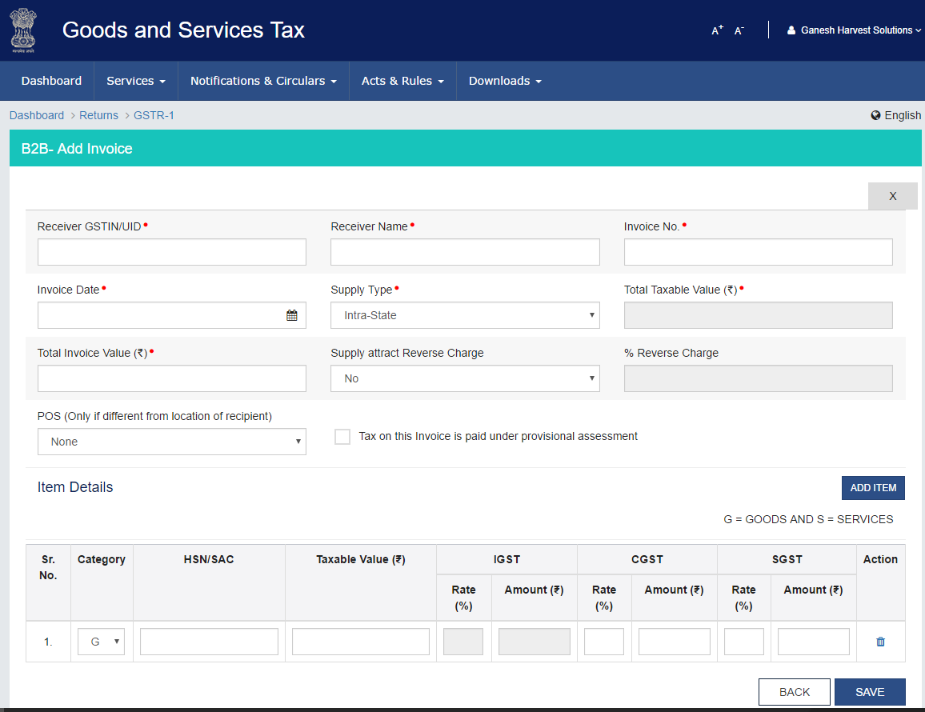

Slide 62
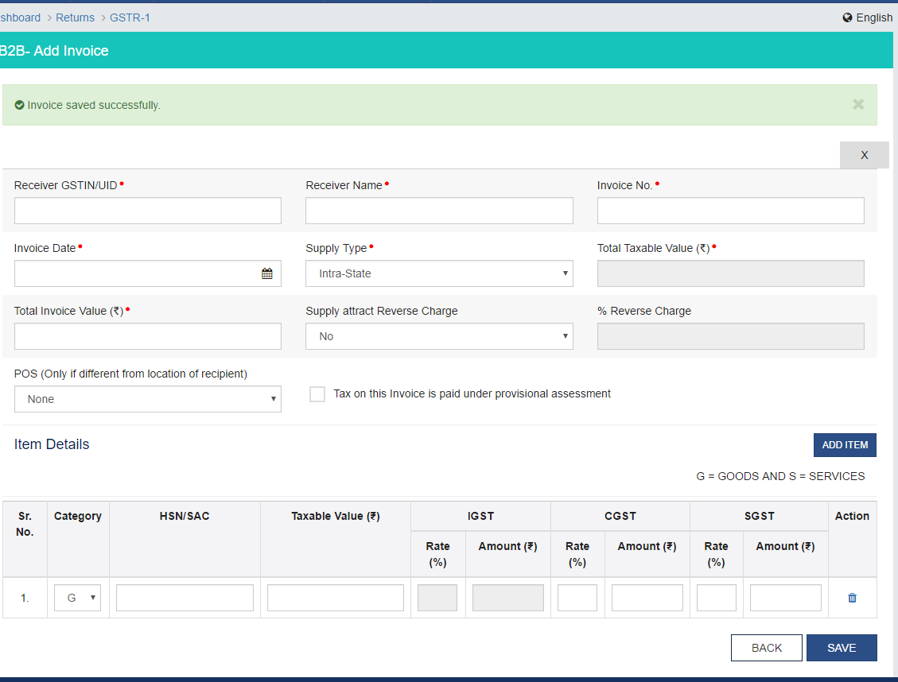

Slide 63
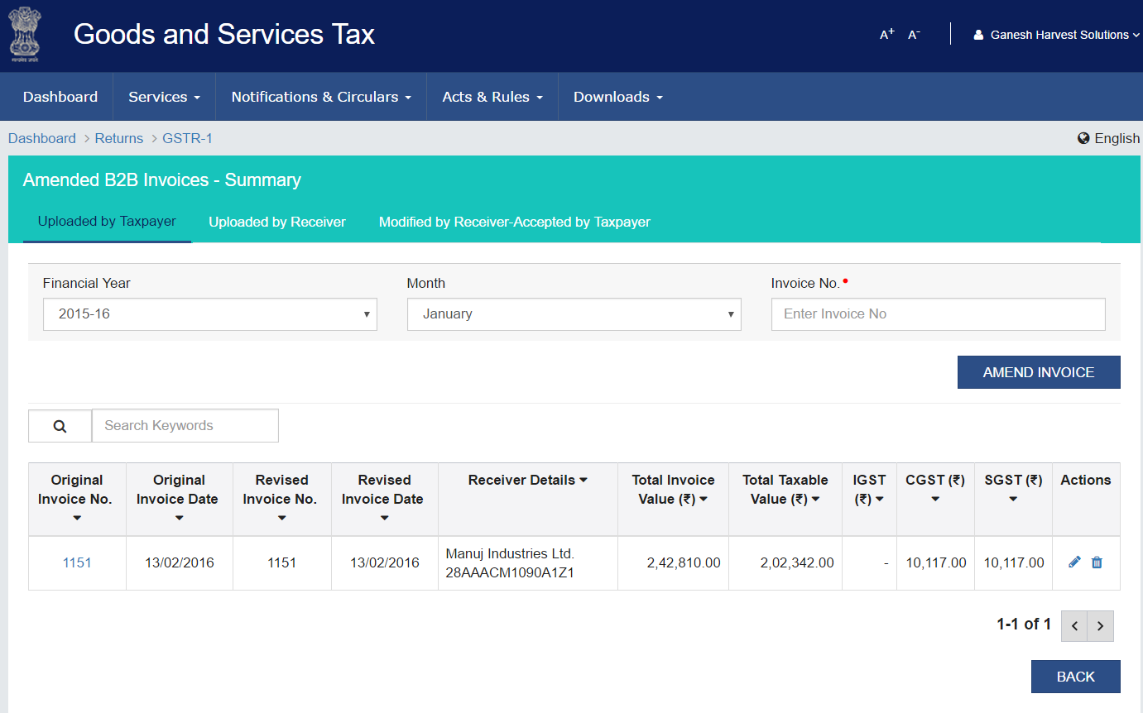

Slide 64
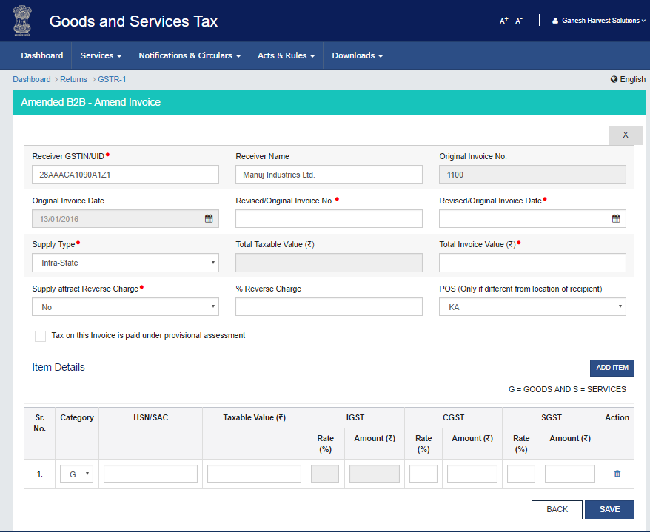

Slide 65
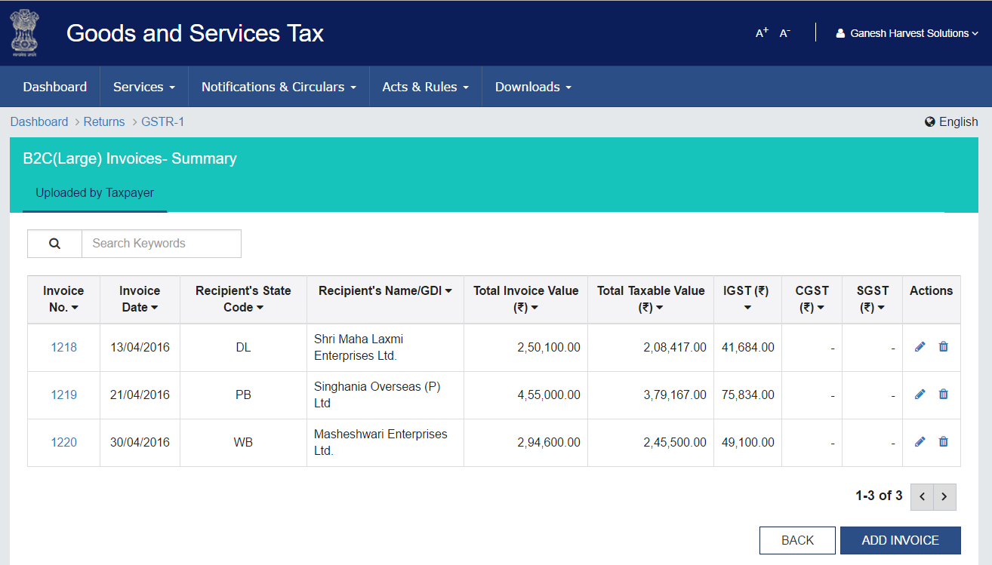

Slide 66
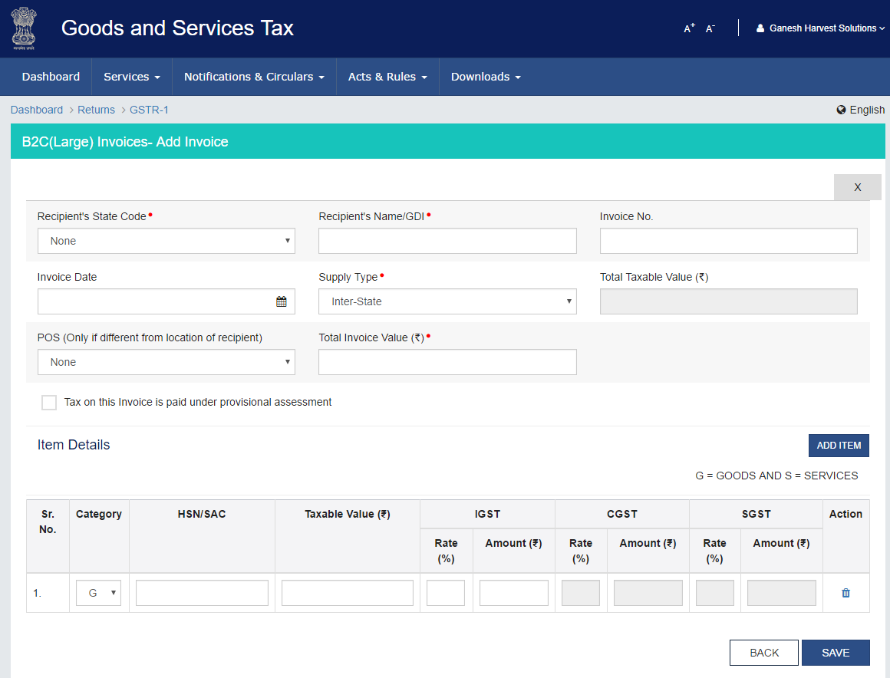

Slide 67
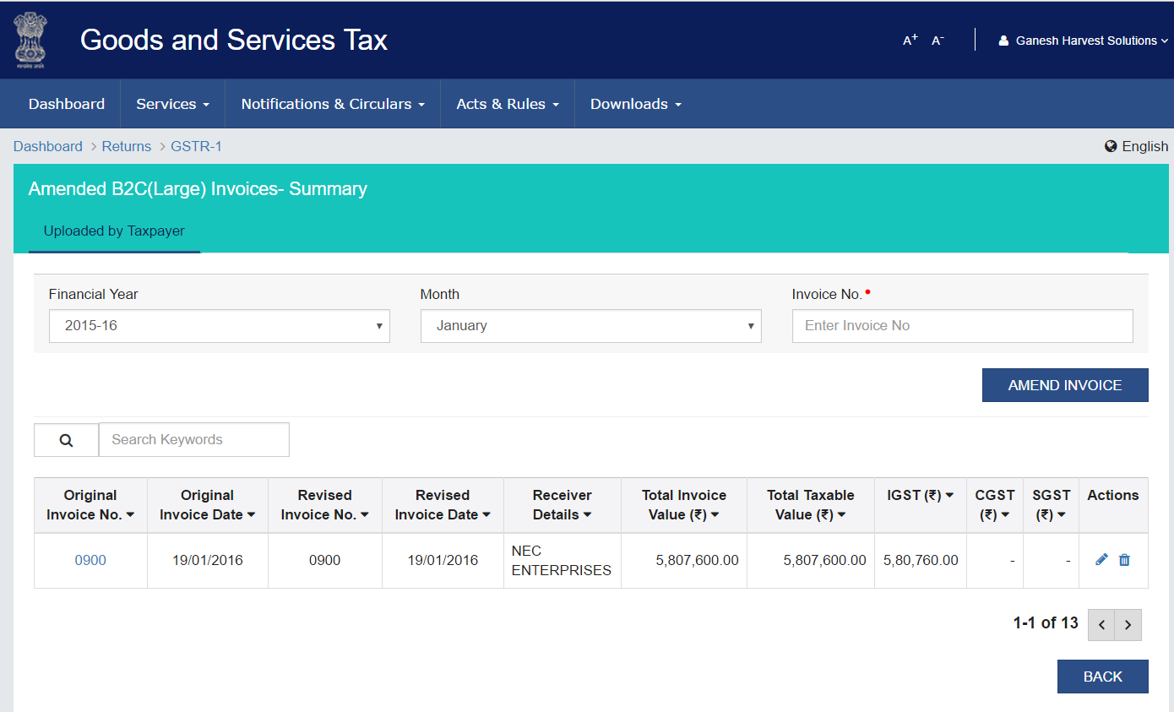

Slide 68
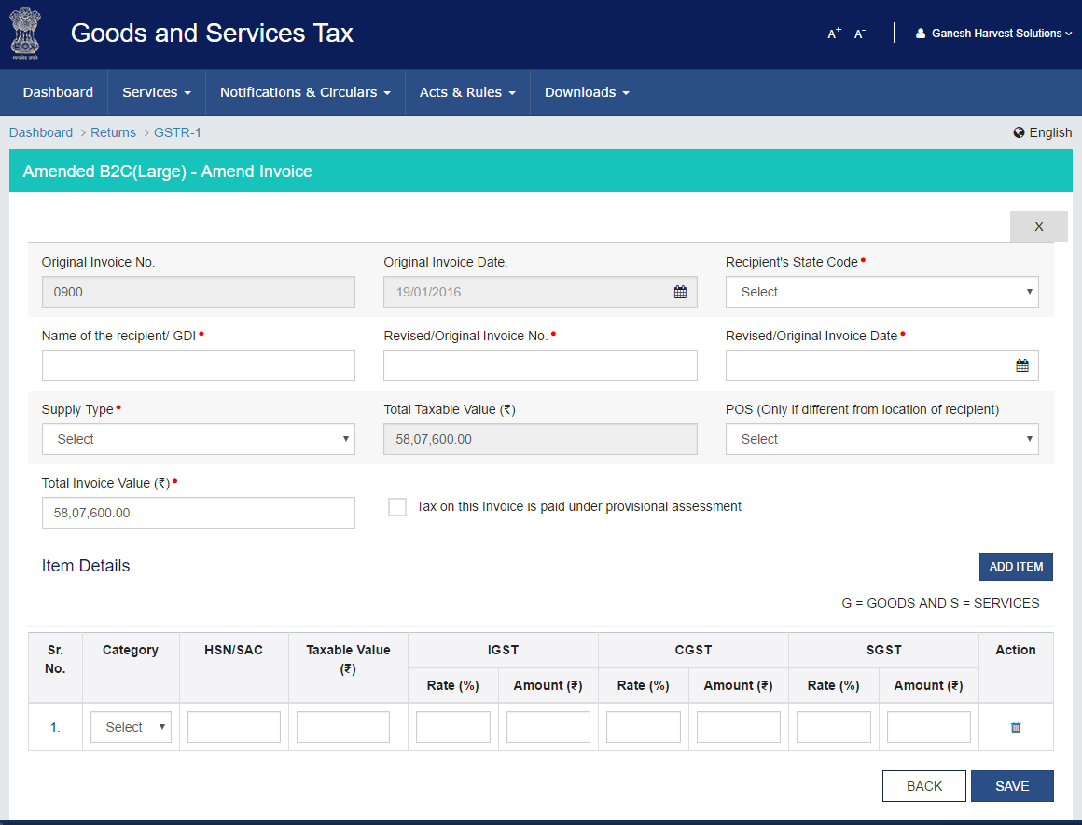

Slide 69
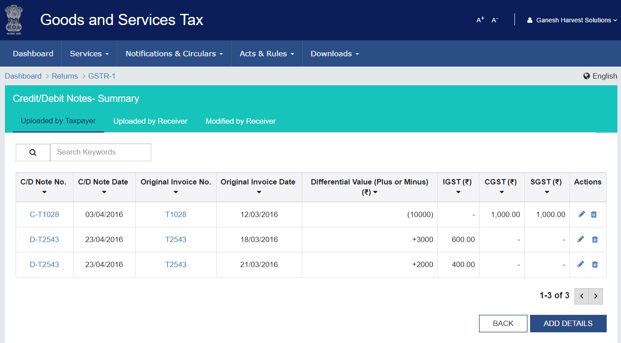

Slide 70
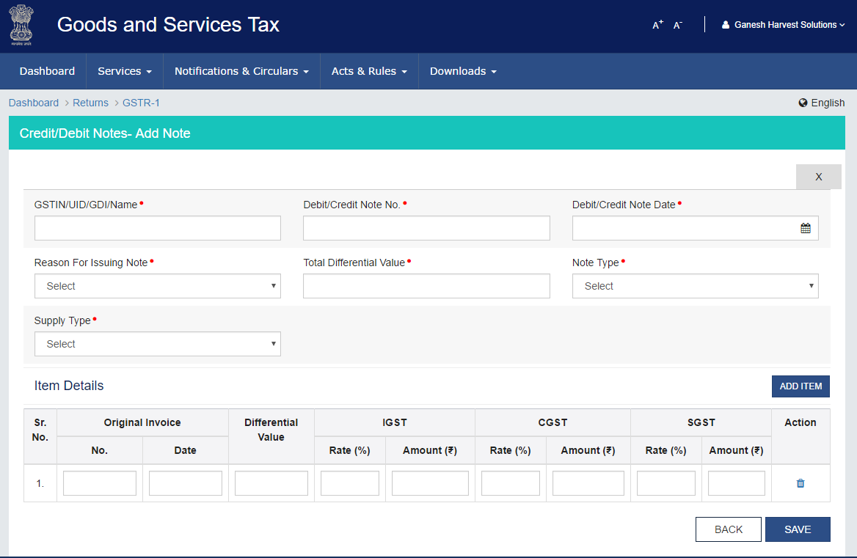

Slide 71
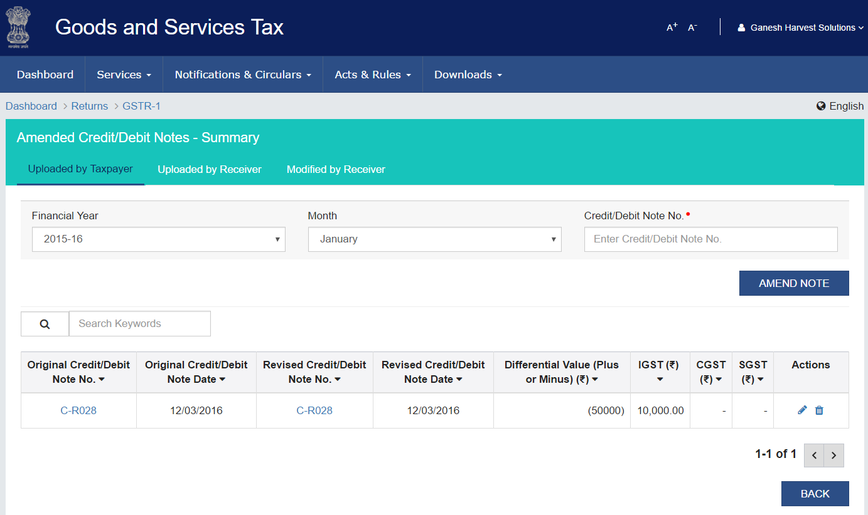

Slide 72
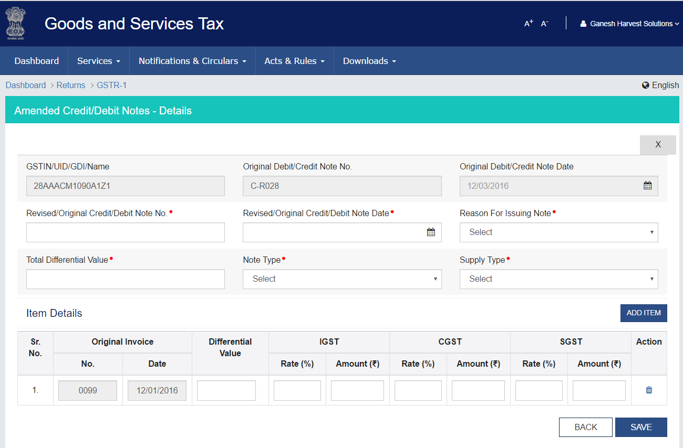

Slide 73
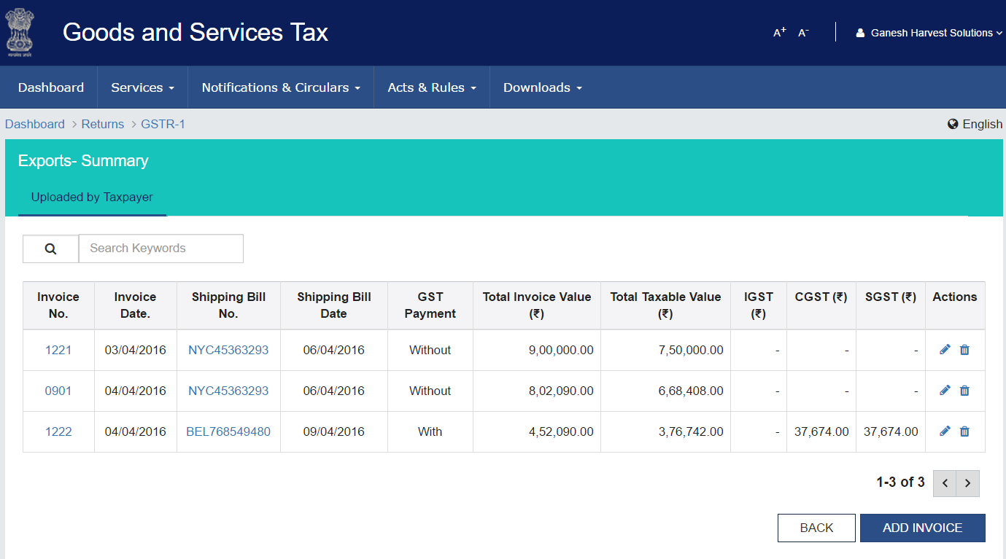

Slide 74
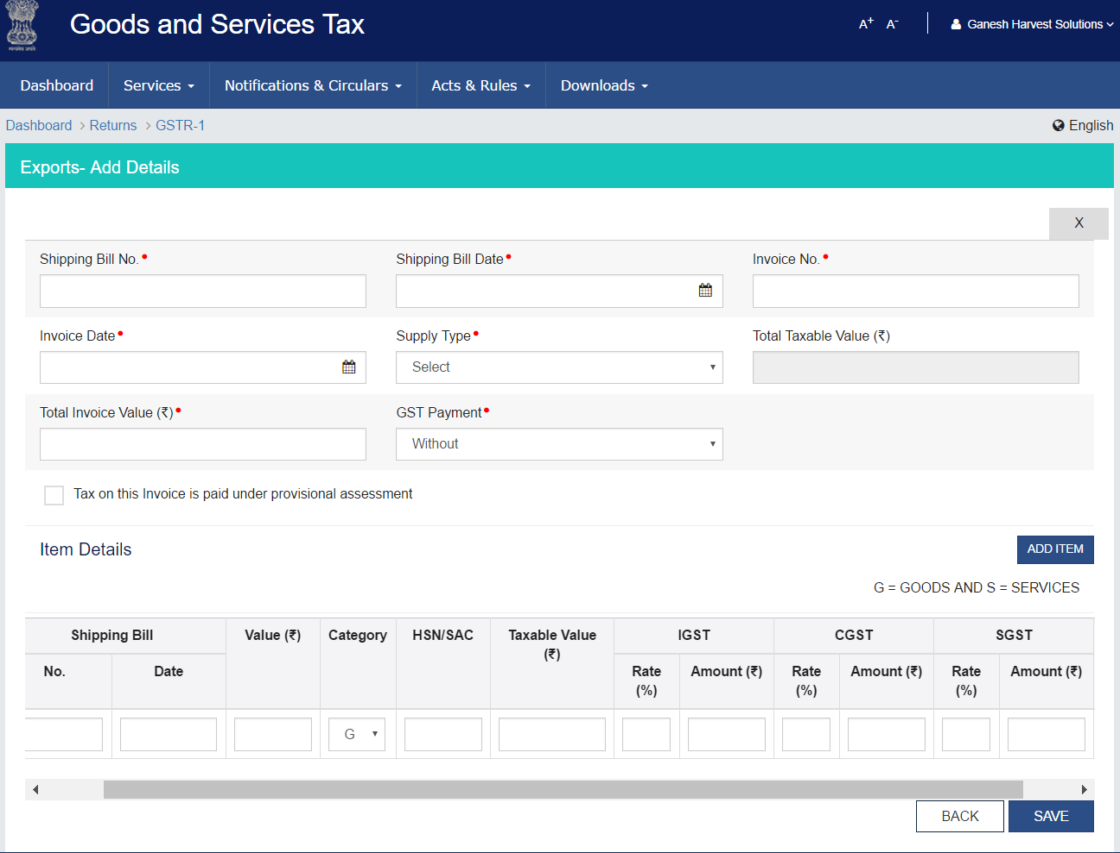

Slide 75
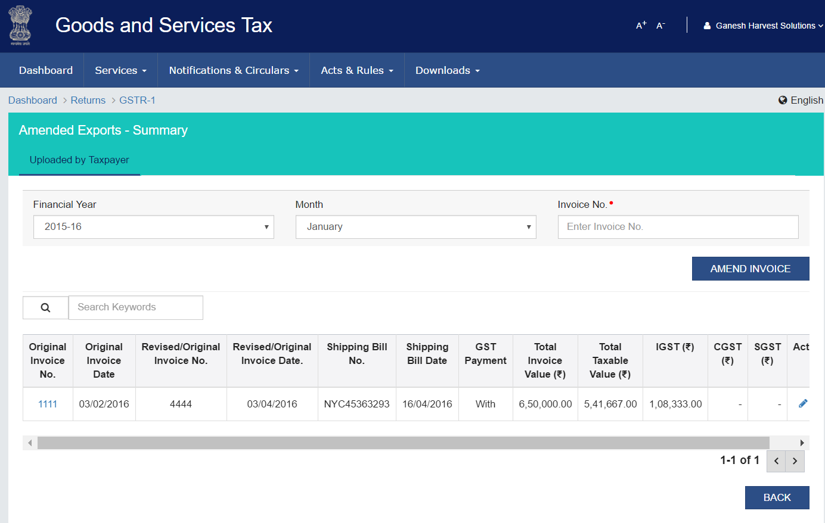

Slide 76
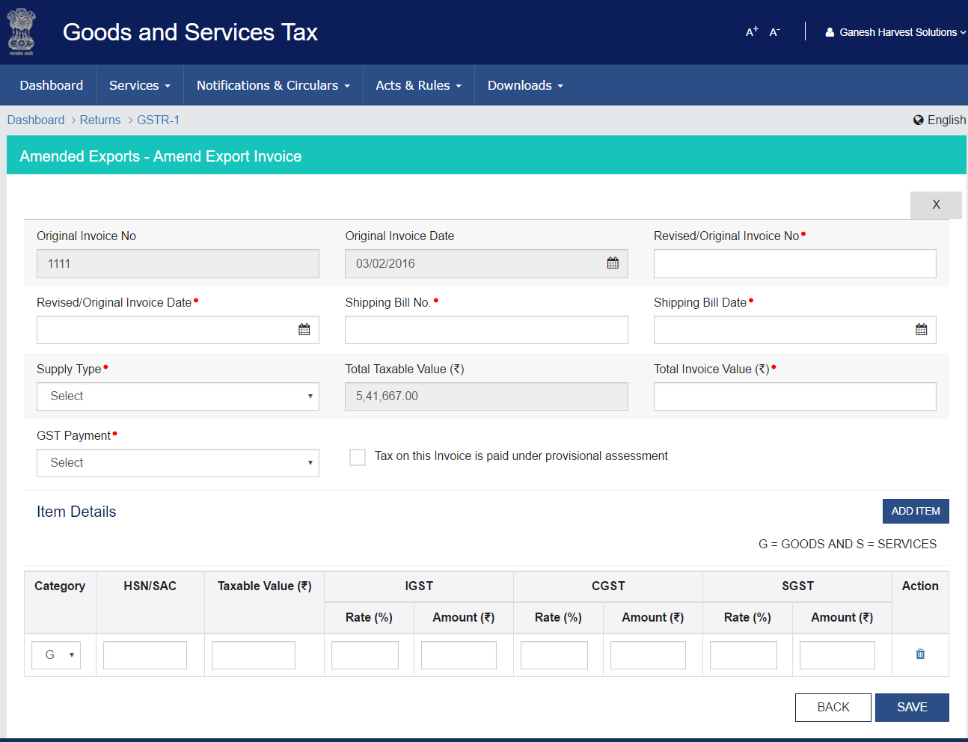

Slide 77
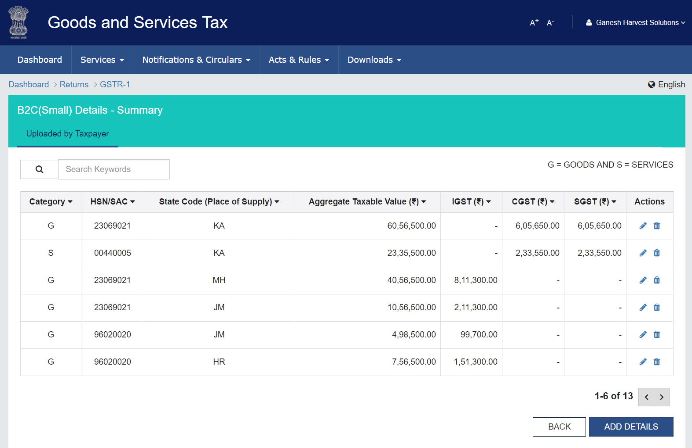

Slide 78
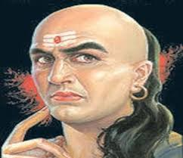
“Taxation should not be a painful process for the people. There should be leniency and caution while deciding the tax structure. Ideally, governments should collect taxes like a honeybee, which sucks just the right amount of honey from the flower so that both can survive. Taxes should be collected in small and
not in large proportions." -- Arthashastra
Chanakya………

Slide 79
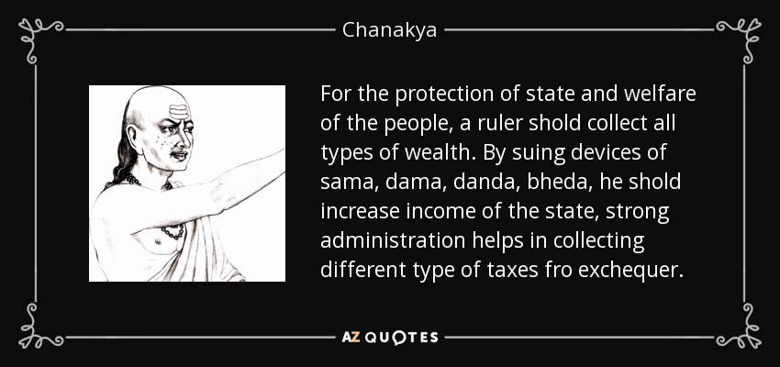

Slide 80


